Slide 1



Social Bazz
Presented By
B. Dattesh

Slide 2


Today's agenda
Project Recap
To provide a high-level overview of the business problem we're tackling and the precise requirements, we will provide a summary of the entire project.
Problem
We will get into the particular issue that the Data Analytics team has been concentrating on and provide some context for why this is such a significant issue.
The Analytics Team
I'll start by outlining the issue and then discuss the team that is in charge of handling this assignment on our end.
Process
After that, I'll go into the general steps we took to do this assignment so you can fully understand how we approach tasks of this nature.
Insights & Summary
Lastly, I will review all significant findings and offer them as a collection of understandings and illustrations from our
Presented By
B. Dattesh

Slide 3

"Social Buzz" is a rapidly expanding unicorn in the technology space that needs to quickly adjust to its global reach.
Accenture has started working on the following activities during a three-month POC :
An examination of Social Buzz's use of big data
Strategies for a prosperous initial public offering (IPO)
An examination to determine the top 5 content categories on Social Buzz
Project Recap
Presented By
B. Dattesh

Slide 4

Problem
"Social Buzz" is a rapidly expanding unicorn in the technology space that needs to quickly adjust to its global reach.
Accenture has started working on the following activities during a three-month POC :
An examination of Social Buzz's use of big data
Strategies for a prosperous initial public offering (IPO)
An examination to determine the top 5 content categories on Social Buzz
Presented By
B. Dattesh

Slide 5


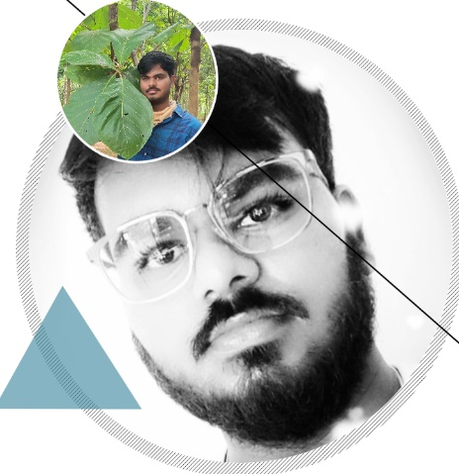
ANDREW FLEMING
Chief Technology
Architect
The Analytics team
MARCUS ROMPTION
Senior Principal
BADAGANCHI DATTESH
Data Analyst
Presented By
B. Dattesh

Slide 6
Understanding Data
Process
1
Data Cleaning
2
Data Modelling
3
4
Data Analysis
5
Uncover Insights
Presented By
B. Dattesh

Slide 7

Insights
Category With Highest Score
Unique Categories
Month with
Most Posts
Animals
16
1897
May
Presented By
B. Dattesh

Slide 8
Presented By
B. Dattesh

Slide 9
Presented By
B. Dattesh

Slide 10

ANALYSIS
Animals and science are two of the most popular content categories, this shows that people enjoy “real-life” and “factual” content the most. So I would recommend that you keep creating more contents relating to these two categories.
INSIGHT
Food is a common theme with the top 5 categories with “Healthy Eating” ranking as one of the highest. This may give an indication to the audience within your user base. You could use this insight to create a campaign and work with healthy eating brands to boost user engagement.
Summary
NEXT STEPS
It should come as no surprise that technological content is among the top categories given the advancement of technology. It indicates that users like your technological material. Working with some of the biggest digital companies in the world is something I would suggest doing because it would undoubtedly increase user engagement.
Presented By
B. Dattesh

Slide 11
Thank you!
ANY QUESTIONS?
Presented By
B. Dattesh

